Slide 1
Real-time Cardiovascular MR with Spatio-temporal artifact suppression using deep learning – proof of concept in congenital heart disease
Authors: Andreas Hauptmann, Simon Arridge, Felix Lucka, Vivek Muthurangu, Jennifer A. Steeden
Presentation by David Scobie

Slide 2
Introduction
Background
Conventionally CMR is used to find ventricular volumes
Some patients find this hard
PA pressure goes up, physiology change
We want reduced scan times

Slide 3
Introduction
Real time imaging
Non-cartesian trajectories
Data Undersampling
Compressed Sensing (CS)
Parallel Imaging

Slide 4
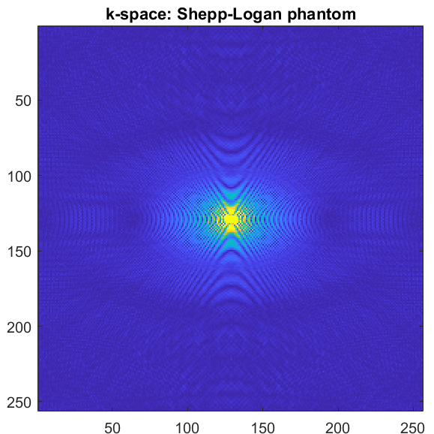
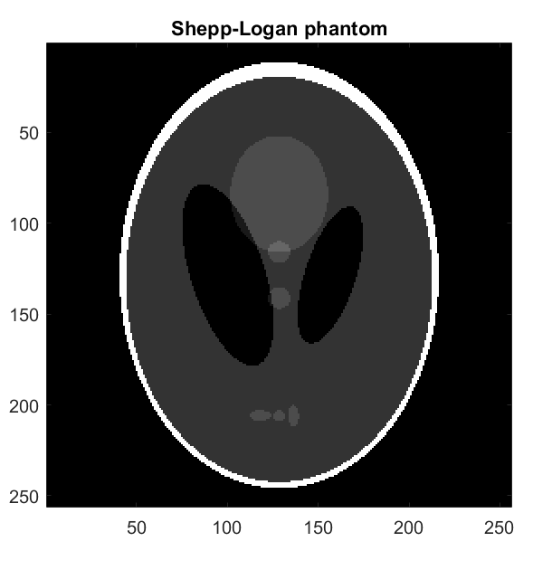
Introduction
Trajectories and k-space undersampling
Fully sampled k space

Slide 5
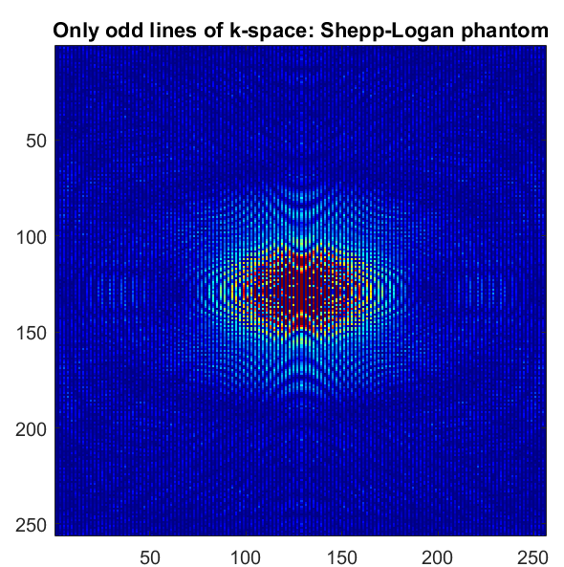
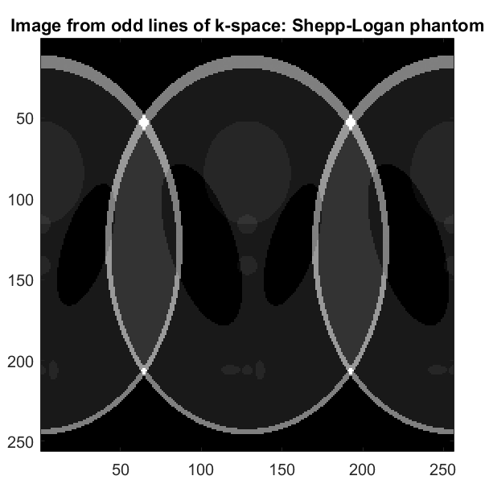
Introduction
Trajectories and k-space undersampling
Cartesian undersampling

Slide 6
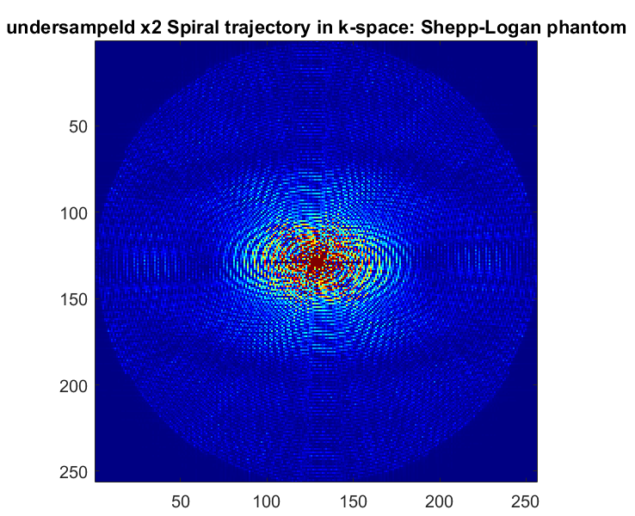
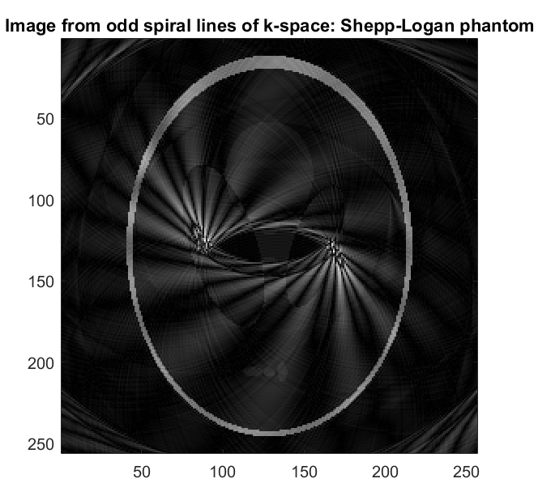
Introduction
Trajectories and k-space undersampling
Spiral undersampling

Slide 7
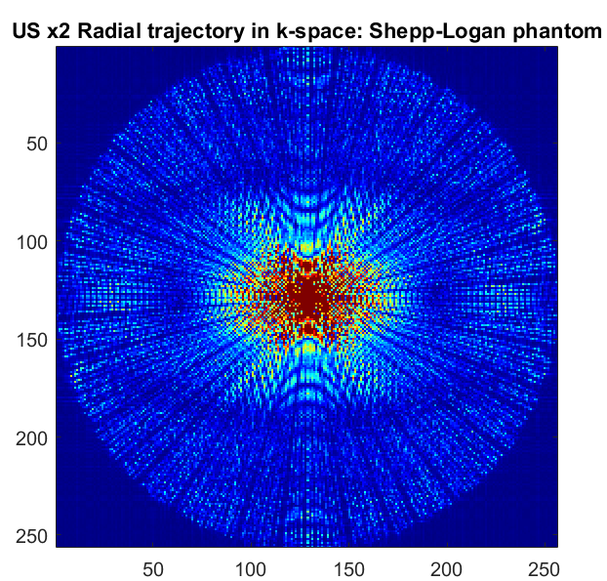
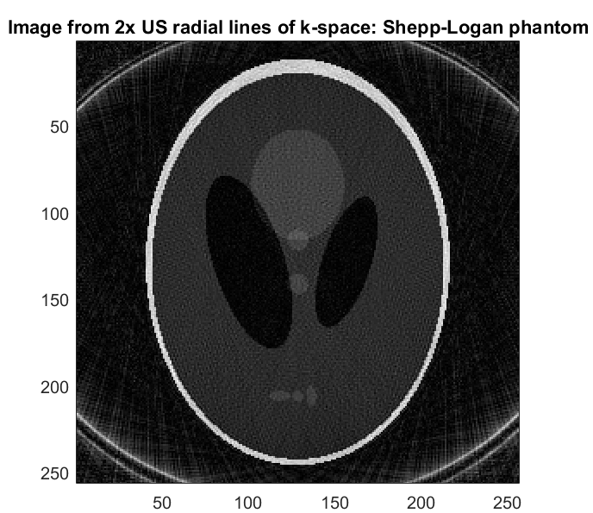
Introduction
Trajectories and k-space undersampling
Radial undersampling

Slide 8
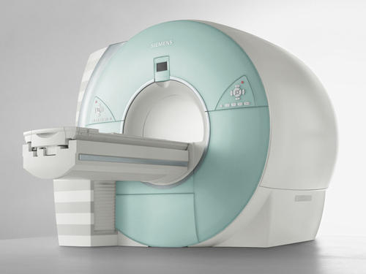
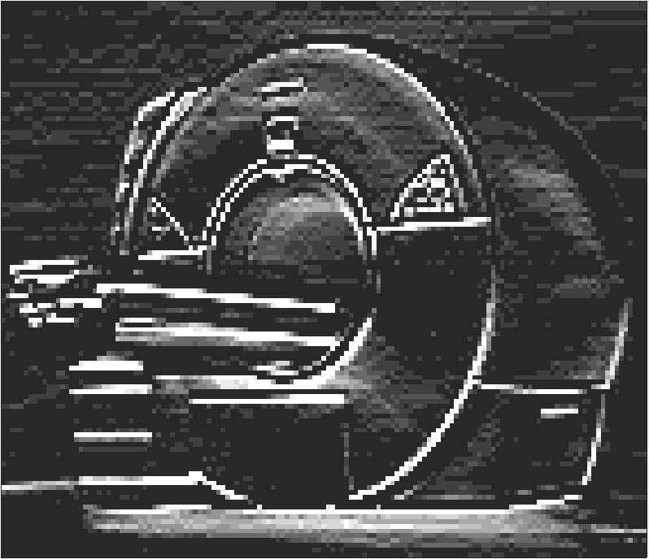
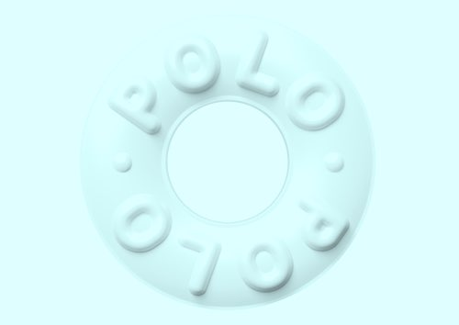
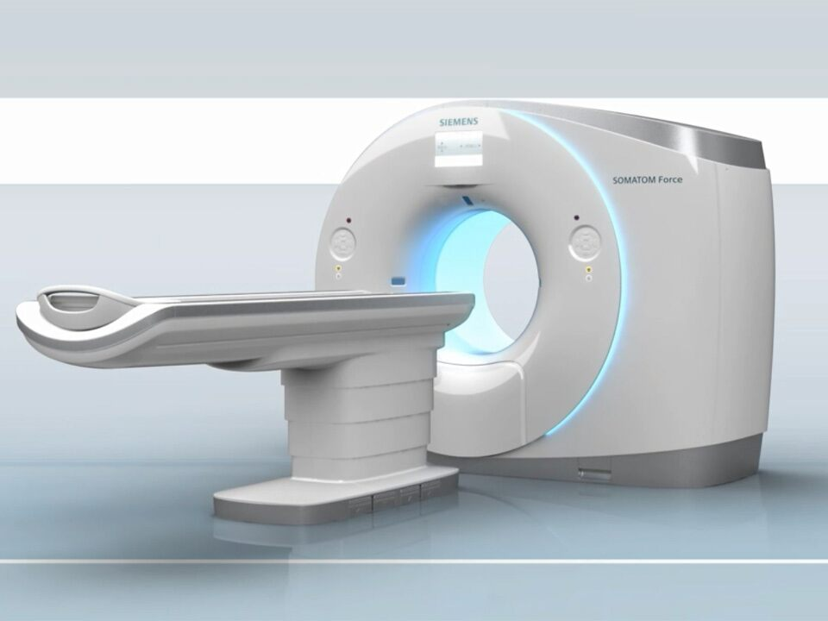
Introduction
Machine Learning
Convolution
Pooling
Convolution
Pooling
CNN
Acquire less data and learn to map to cleaner image
Convolution and pooling layers (image)
Bh-SSfp
(Convolution and pooling image)

Slide 9
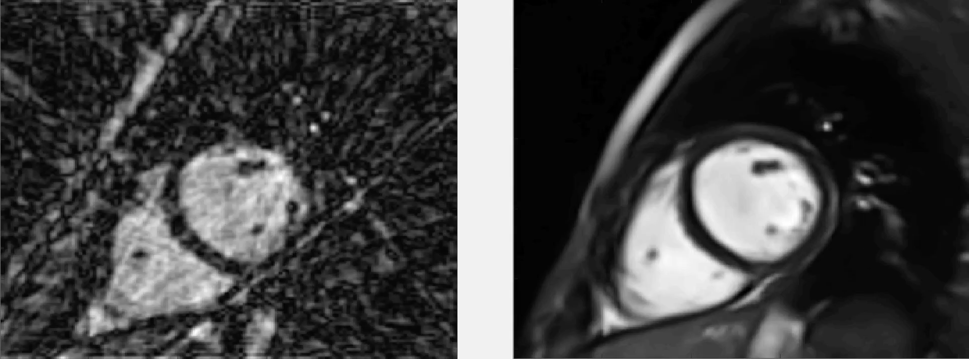

Machine Learning: Network
2D and 3D CNN’s
Below, we see a result of a CNN trained on a 2D structure
Video S1 in supporting information
3D structure (used in paper) means we don’t see flickering as seen in a 2D slice by slice approach
Notes:
There are two main drawbacks of CS, which can limit their clinical uptake: i) they are very computationally intensive and time consuming, and ii) optimisation of reconstruction parameters is challenging, which can lead to unnatural looking images.
A very recently proposed solution is to incorporate machine learning into image reconstruction.
Machine learning networks are becoming a state-of-the-art technique for image de-noising. So the idea is, can we perform a simple reconstruction of under sampled images which produces aliased images, and train a network to remove the aliasing, similarly to a de-noising problem.
The convolutional neural network consists of convolution and pooling layers. The network learn the convolutional filters to map between aliased images and ground truth images, using training data.
To do this we take gold-standard Cartesian BH data, and synthetically under sample them. This paired data fed into the network, for training of the parameters.
The resultant network, can them be presented with a previously unseen aliased data set, and produce an artefact-free image.

Slide 10
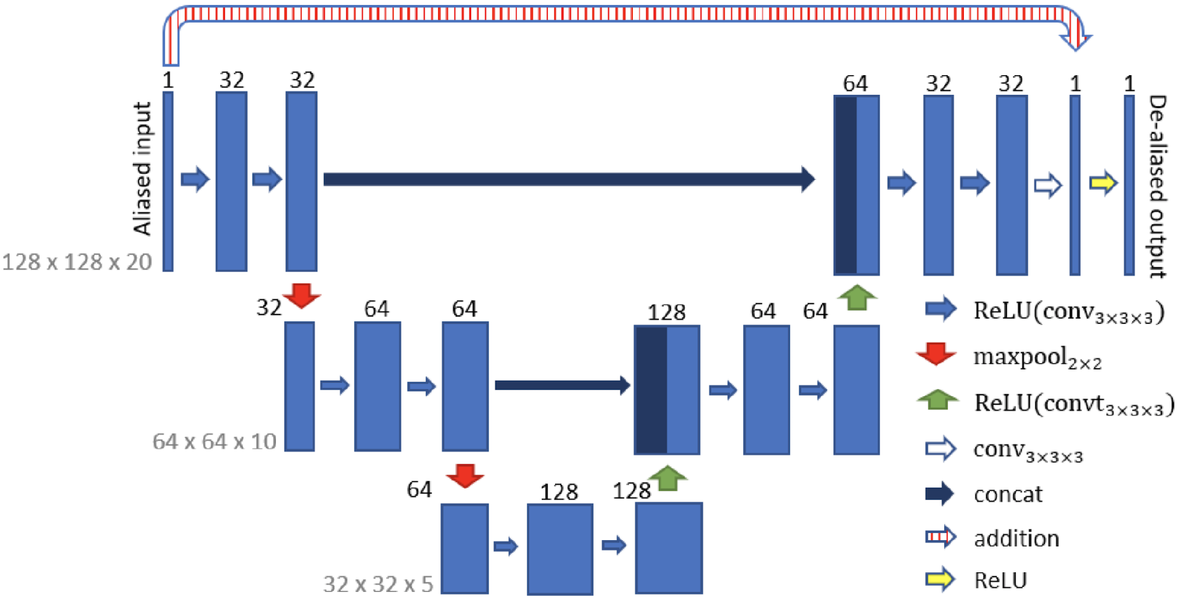
Machine Learning: Network
CNN network map
Figure 3
Notes:
There are two main drawbacks of CS, which can limit their clinical uptake: i) they are very computationally intensive and time consuming, and ii) optimisation of reconstruction parameters is challenging, which can lead to unnatural looking images.
A very recently proposed solution is to incorporate machine learning into image reconstruction.
Machine learning networks are becoming a state-of-the-art technique for image de-noising. So the idea is, can we perform a simple reconstruction of under sampled images which produces aliased images, and train a network to remove the aliasing, similarly to a de-noising problem.
The convolutional neural network consists of convolution and pooling layers. The network learn the convolutional filters to map between aliased images and ground truth images, using training data.
To do this we take gold-standard Cartesian BH data, and synthetically under sample them. This paired data fed into the network, for training of the parameters.
The resultant network, can them be presented with a previously unseen aliased data set, and produce an artefact-free image.

Slide 11
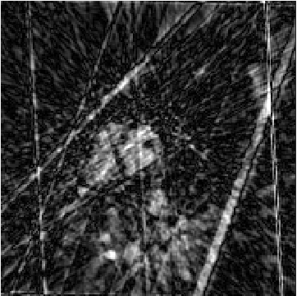
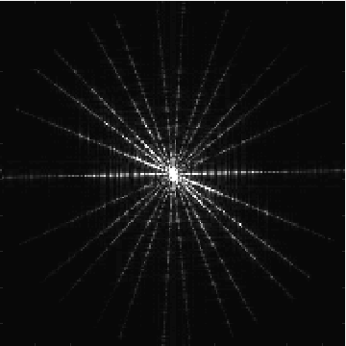
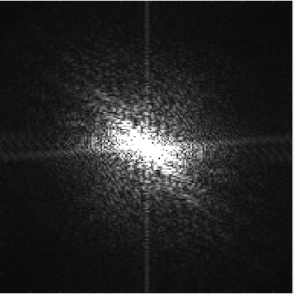
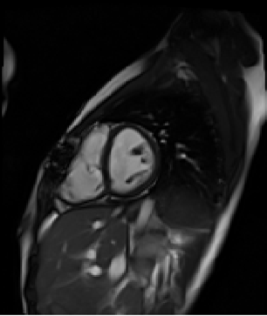
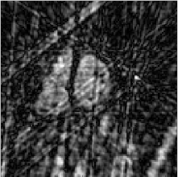
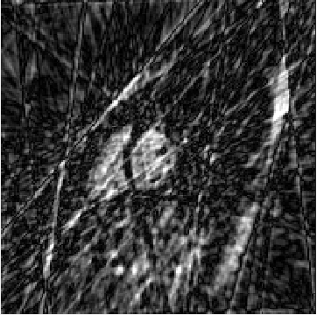
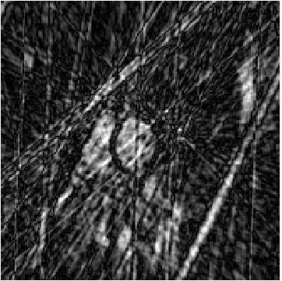
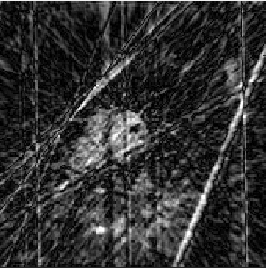
Methods
Synthetic training data
192 pixels
192 pixels
128 pixels
192 pixels
192 pixels
~240 pixels
128 pixels
128 pixels
…
…
…
…
…
…
…
…
20 frames
20 frames
40 frames
No. frames =
R-R interval / 36.4
128 pixels
128 pixels
No. frames =
R-R interval / 36.4
(rounded down)
No. frames =
R-R interval / 36.4
No. frames =
R-R interval / 36.4
128 pixels
No. frames =
R-R interval / 36.4
~204 pixels
192 pixels
192 pixels
192 pixels
192 pixels
Fourier transform into k-space
Grid onto undersampled radial trajectory
Inverse Fourier transform into image-space .
Crop to 128 matrix
Temporal interpolation
Normalise signal intensities
Retrospectively cardiac-gated bSSFP cine
Spatial and temporal interpolation
Temporal interpolation to convert retrospectively cardiac gated data to ‘synthetic’ real-time data
R-R interval
BH-bSSFP
40 frames
‘Synthetic’
real-time
Number of frames =
R-R interval / 36.4
(rounded down)
…
Note the final part-frame is discarded,
meaning that end-diastole is not included
36.4 ms
(temporal resolution of the real-time sequence)
Notes:
There are two main drawbacks of CS, which can limit their clinical uptake: i) they are very computationally intensive and time consuming, and ii) optimisation of reconstruction parameters is challenging, which can lead to unnatural looking images.
A very recently proposed solution is to incorporate machine learning into image reconstruction.
Machine learning networks are becoming a state-of-the-art technique for image de-noising. So the idea is, can we perform a simple reconstruction of under sampled images which produces aliased images, and train a network to remove the aliasing, similarly to a de-noising problem.
The convolutional neural network consists of convolution and pooling layers. The network learn the convolutional filters to map between aliased images and ground truth images, using training data.
To do this we take gold-standard Cartesian BH data, and synthetically under sample them. This paired data fed into the network, for training of the parameters.
The resultant network, can them be presented with a previously unseen aliased data set, and produce an artefact-free image.

Slide 12
Methods
Radial undersampling strategies
Constant angle, no rotation:
Constant angle, with rotation:
Tiny golden angle (22.63), no rotation:
Tiny golden angle with rotation:
Figure 1
Notes:
There are two main drawbacks of CS, which can limit their clinical uptake: i) they are very computationally intensive and time consuming, and ii) optimisation of reconstruction parameters is challenging, which can lead to unnatural looking images.
A very recently proposed solution is to incorporate machine learning into image reconstruction.
Machine learning networks are becoming a state-of-the-art technique for image de-noising. So the idea is, can we perform a simple reconstruction of under sampled images which produces aliased images, and train a network to remove the aliasing, similarly to a de-noising problem.
The convolutional neural network consists of convolution and pooling layers. The network learn the convolutional filters to map between aliased images and ground truth images, using training data.
To do this we take gold-standard Cartesian BH data, and synthetically under sample them. This paired data fed into the network, for training of the parameters.
The resultant network, can them be presented with a previously unseen aliased data set, and produce an artefact-free image.

Slide 13
Methods
Comparison of radial undersampling strategies
Ground truth Constant angle, no rotation:
Constant angle, with rotation:
Tiny golden angle, no rotation:
Tiny golden angle with rotation:
Figure 2
tGA_{rot} most alike to ground truth
Notes:
There are two main drawbacks of CS, which can limit their clinical uptake: i) they are very computationally intensive and time consuming, and ii) optimisation of reconstruction parameters is challenging, which can lead to unnatural looking images.
A very recently proposed solution is to incorporate machine learning into image reconstruction.
Machine learning networks are becoming a state-of-the-art technique for image de-noising. So the idea is, can we perform a simple reconstruction of under sampled images which produces aliased images, and train a network to remove the aliasing, similarly to a de-noising problem.
The convolutional neural network consists of convolution and pooling layers. The network learn the convolutional filters to map between aliased images and ground truth images, using training data.
To do this we take gold-standard Cartesian BH data, and synthetically under sample them. This paired data fed into the network, for training of the parameters.
The resultant network, can them be presented with a previously unseen aliased data set, and produce an artefact-free image.

Slide 14
Methods
In vivo data
10 patients with CHD (mean age: 33.6±16.8 years, male: 3)
radial tGA_{rot} trajectory used.
Undersampled data taken and reconstructed with CNN and GRASP techniques.
Notes:
There are two main drawbacks of CS, which can limit their clinical uptake: i) they are very computationally intensive and time consuming, and ii) optimisation of reconstruction parameters is challenging, which can lead to unnatural looking images.
A very recently proposed solution is to incorporate machine learning into image reconstruction.
Machine learning networks are becoming a state-of-the-art technique for image de-noising. So the idea is, can we perform a simple reconstruction of under sampled images which produces aliased images, and train a network to remove the aliasing, similarly to a de-noising problem.
The convolutional neural network consists of convolution and pooling layers. The network learn the convolutional filters to map between aliased images and ground truth images, using training data.
To do this we take gold-standard Cartesian BH data, and synthetically under sample them. This paired data fed into the network, for training of the parameters.
The resultant network, can them be presented with a previously unseen aliased data set, and produce an artefact-free image.

Slide 15
Results
Acquisition and reconstruction times
Acquisition time
Reference standard BH-bSSFP: 279±65 s
Real-time radial bSSFP: 18±3 s
Reconstruction Time: (radial data, all slices)
Deep artifact suppression: ~22.0 s
GRASP : ~111.4 s
CNN far quicker than GRASP
Notes:
There are two main drawbacks of CS, which can limit their clinical uptake: i) they are very computationally intensive and time consuming, and ii) optimisation of reconstruction parameters is challenging, which can lead to unnatural looking images.
A very recently proposed solution is to incorporate machine learning into image reconstruction.
Machine learning networks are becoming a state-of-the-art technique for image de-noising. So the idea is, can we perform a simple reconstruction of under sampled images which produces aliased images, and train a network to remove the aliasing, similarly to a de-noising problem.
The convolutional neural network consists of convolution and pooling layers. The network learn the convolutional filters to map between aliased images and ground truth images, using training data.
To do this we take gold-standard Cartesian BH data, and synthetically under sample them. This paired data fed into the network, for training of the parameters.
The resultant network, can them be presented with a previously unseen aliased data set, and produce an artefact-free image.

Slide 16
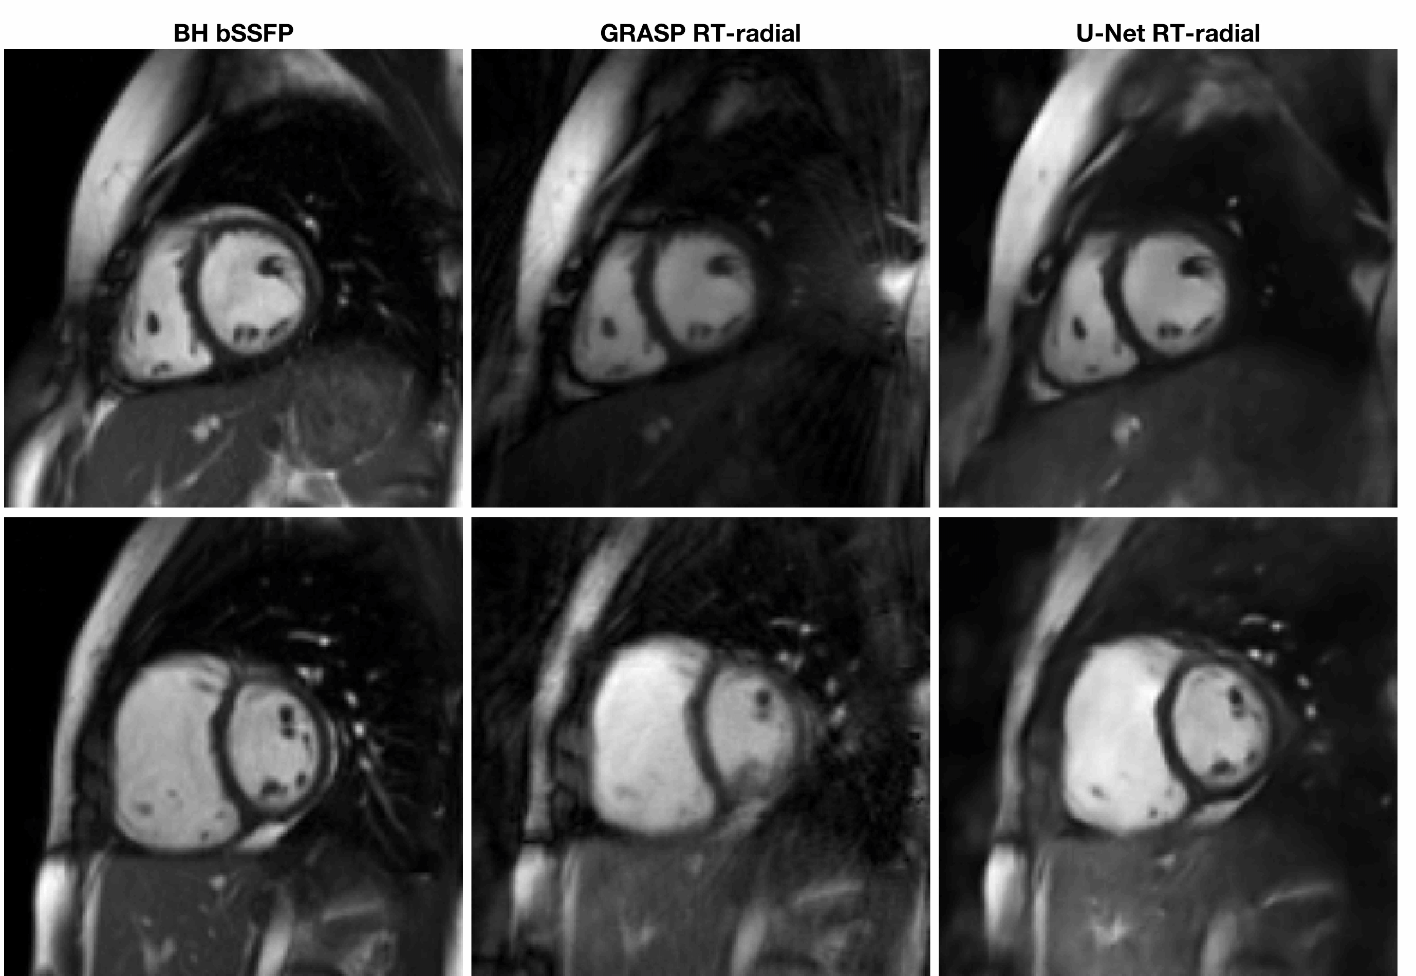
Results
Image quality
Breath hold
CS - 111s recon
U-Net - 22s recon
Video S3 supporting information (The still version of figure 5)

Slide 17
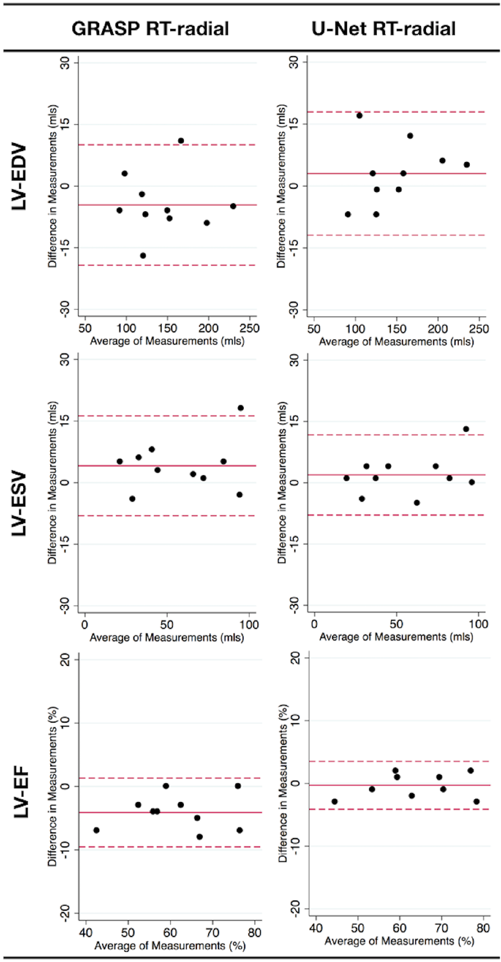
Results
Left ventricle analysis
 | Mean ± Standard deviation |  |  | Bias (Limits of agreement)
 | BH-bSSFP | RT GRASP | RT U-Net | RT GRASP | RT U-Net
LV EDV (mL) | 148 ± 44 | 143 ± 44 | 151 ± 46 | -4.6 (-19.2 to 10.0) | 3.0 (-11.9 to 17.9)
LV ESV (mL) | 56 ± 27 | 60 ± 29* | 58 ± 29 | 4.1 (-8.0 to 16.2) | 1.9 (-7.9 to 11.7)
LV EF (%) | 64 ± 10 | 60 ± 11*† | 63 ± 11 | -4.1 (-9.5 to 1.3) | -0.3 (-4.1 to 3.5)
EDV
ESV
EF

Slide 18
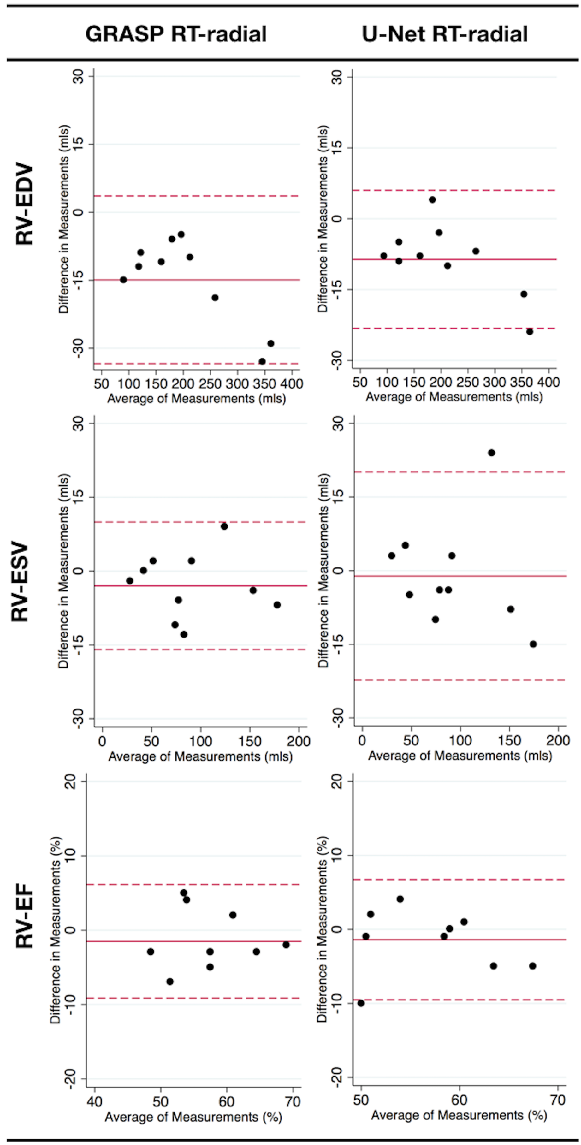
Results
Right ventricle analysis
 | Mean ± Standard deviation |  |  | Bias (Limits of agreement)
 | BH-bSSFP | RT GRASP | RT U-Net | RT GRASP | RT U-Net
RV EDV (mL) | 213 ± 97 | 198 ± 89*† | 204 ± 92 | -14.9 (-33.4 to 3.6) | -8.6 (-23.2 to 6.0)
RV ESV (mL) | 92 ± 49 | 89 ± 48 | 91 ± 47* | -3.0 (-16.0 to 10.0) | -1.1 (-22.3 to 20.1)
RV EF (%) | 58 ± 7 | 57 ± 6 | 57 ± 6 | -1.5 (-9.1 to 6.1) | -1.4 (-9.5 to 6.7)
EDV
ESV
EF

Slide 19
Conclusion
Conclusion
U-net can suppress artifacts in real time data
U-net had very short reconstruction times
Statistical significance
Adoption into clinical practice
Sick patients and non-breath holders.

Slide 20
Jenny’s slides

Slide 21

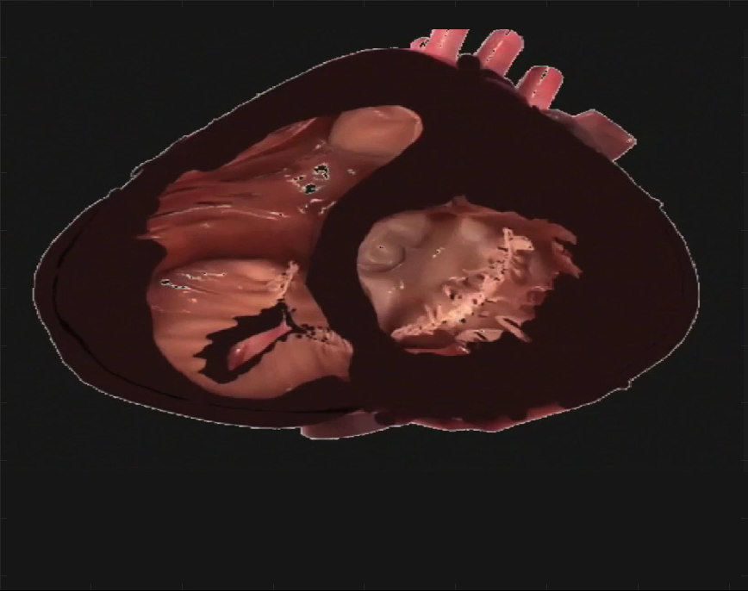
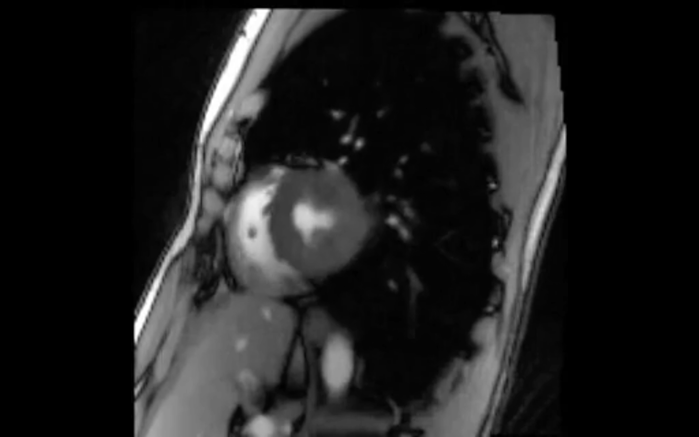
Speeding Up Imaging
Hardware Improvements
Parallel
Imaging
Non-Cartesian trajectories
Temporal
Encoding
Data Undersampling
Compressive Sensing
Zhang, et al. Quant Imaging Med Surg. 2014
Notes:
So how can we achieve real-time imaging?
One way of going faster is through faster gradient switching and higher gradient amplitudes. However, we have probably reached the practical limits of gradients due to power consumption and Peripheral nerve stimulation
Additionally, fast and large gradients generate acoustic noise which may be an important consideration in real-time imaging.
These factors mean that few real performance increases of gradients can be expected.
(time taken - problem not catheter but other stuff)
At the moment all flow information is acquired during free breathing, meaning that the acquisition times are long to compensate for respiratory motion. Functional information is acquired during a breath-hold, however we know from our catheter that the PA pressures increase significantly during breath-holding. This fundamental change in the physiology during breath-holding means that we want to remove the need for all breath-holds.
So how can we reduce the scan times, but maintaining free breathing acquisitions in these patients? One effective way is to acquire the data using real-time techniques.
In order to achieve real-time imaging, we often use non-Cartesian trajectories, including efficient spiral readouts and radial trajectories. Further speed-ups are achieved using data undersampling, with Parallel Imaging or Compressed Sensing reconstruction techniques.
Parallel imaging is a robust method for accelerating the acquisition of magnetic resonance imaging (MRI) data, and has made possible many new applications of MR imaging. Parallel imaging works by acquiring a reduced amount of k-space data with an array of receiver coils.

Slide 22
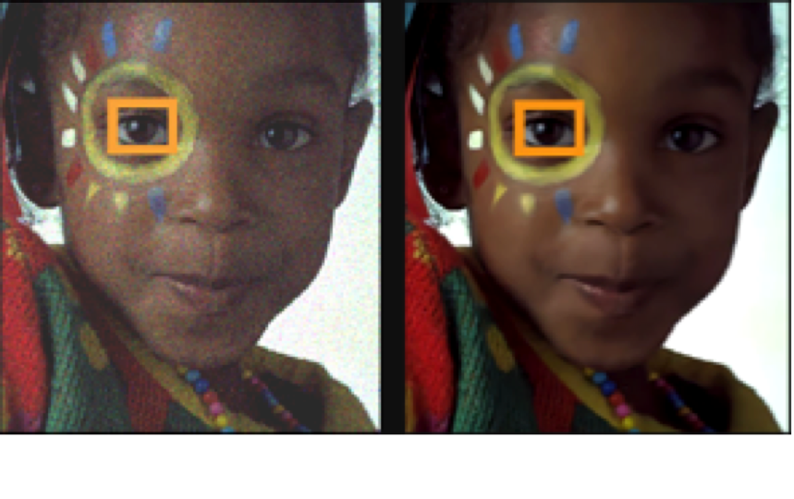
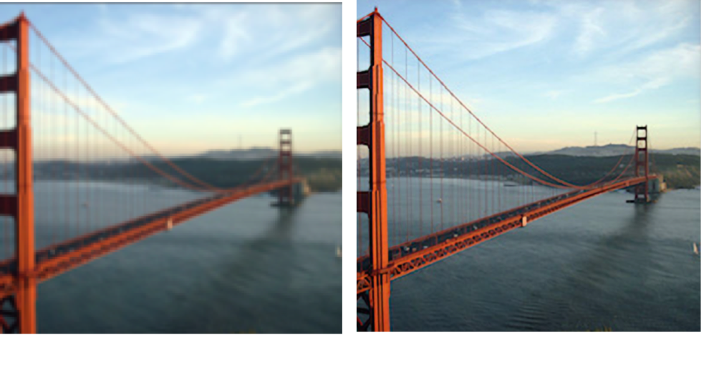
Machine Learning
Convolution
Pooling
Convolution
Pooling
Can we use a Machine Learning Approach?
Image De-noising
Super-resolution
Notes:
So how can we speed up MRIs? We can acquire the raw data in a more efficient way, and collect less data. However, this results in artefacts which makes the images clinically unusable.
I have a lot of experience in model-based computational methods for removal of these artefacts, including Compressive Sensing, however these result in long reconstruction times, which significantly restricts their broader clinical uptake.
In the last 5 years Machine Learning has been increasingly used to improve image quality from photographs – including techniques for image de-noising and super-resolution.
Recently, I have been working on the idea of using ML to speed up the reconstruction of undersampled MR images.

Slide 23
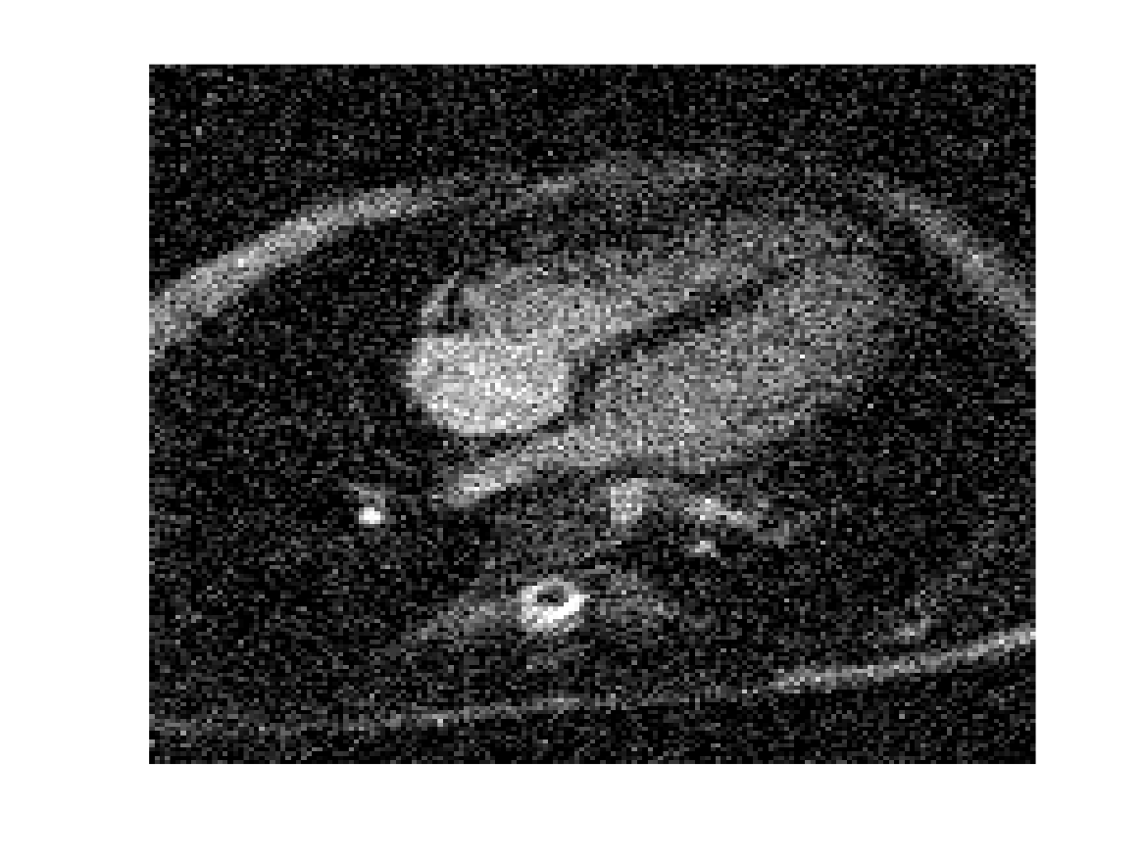
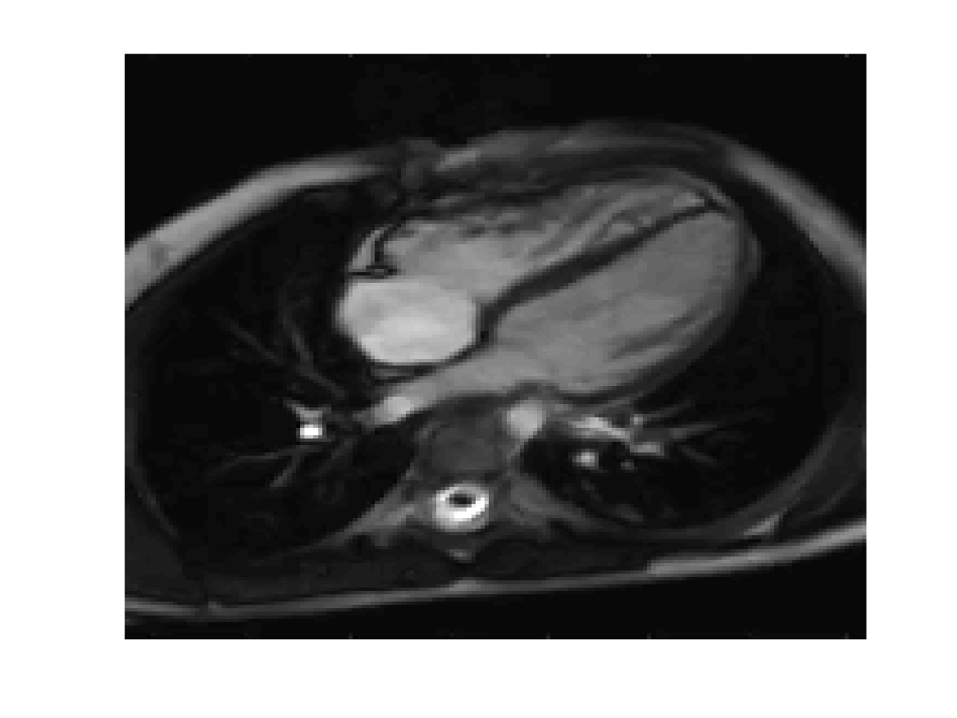
Machine Learning: Denoising
Conventional
Denoising
Convolutional Neural Network
Notes:
There are two main drawbacks of CS, which can limit their clinical uptake: i) they are very computationally intensive and time consuming, and ii) optimisation of reconstruction parameters is challenging, which can lead to unnatural looking images.
A very recently proposed solution is to incorporate machine learning into image reconstruction.
Machine learning networks are becoming a state-of-the-art technique for image de-noising. So the idea is, can we perform a simple reconstruction of under sampled images which produces aliased images, and train a network to remove the aliasing, similarly to a de-noising problem.
The convolutional neural network consists of convolution and pooling layers. The network learn the convolutional filters to map between aliased images and ground truth images, using training data.
To do this we take gold-standard Cartesian BH data, and synthetically under sample them. This paired data fed into the network, for training of the parameters.
The resultant network, can them be presented with a previously unseen aliased data set, and produce an artefact-free image.

Slide 24
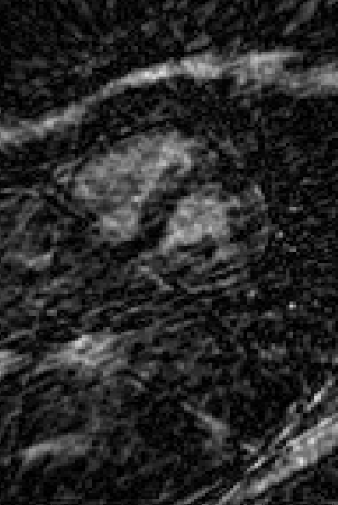
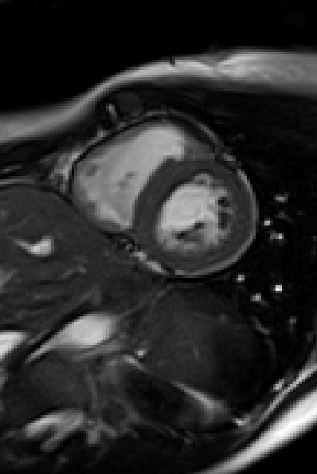
Machine Learning: Principle De-aliasing
Deep
De-aliasing
Convolutional Neural Network
Notes:
There are two main drawbacks of CS, which can limit their clinical uptake: i) they are very computationally intensive and time consuming, and ii) optimisation of reconstruction parameters is challenging, which can lead to unnatural looking images.
A very recently proposed solution is to incorporate machine learning into image reconstruction.
Machine learning networks are becoming a state-of-the-art technique for image de-noising. So the idea is, can we perform a simple reconstruction of under sampled images which produces aliased images, and train a network to remove the aliasing, similarly to a de-noising problem.
The convolutional neural network consists of convolution and pooling layers. The network learn the convolutional filters to map between aliased images and ground truth images, using training data.
To do this we take gold-standard Cartesian BH data, and synthetically under sample them. This paired data fed into the network, for training of the parameters.
The resultant network, can them be presented with a previously unseen aliased data set, and produce an artefact-free image.

Slide 25
Machine Learning: Network
Modified residual U-Net architecture
2D structure; Initial result
Video S1 in supporting information
3D structure (used in paper) means we don’t see flickering as seen in a 2D slice by slice approach
Notes:
There are two main drawbacks of CS, which can limit their clinical uptake: i) they are very computationally intensive and time consuming, and ii) optimisation of reconstruction parameters is challenging, which can lead to unnatural looking images.
A very recently proposed solution is to incorporate machine learning into image reconstruction.
Machine learning networks are becoming a state-of-the-art technique for image de-noising. So the idea is, can we perform a simple reconstruction of under sampled images which produces aliased images, and train a network to remove the aliasing, similarly to a de-noising problem.
The convolutional neural network consists of convolution and pooling layers. The network learn the convolutional filters to map between aliased images and ground truth images, using training data.
To do this we take gold-standard Cartesian BH data, and synthetically under sample them. This paired data fed into the network, for training of the parameters.
The resultant network, can them be presented with a previously unseen aliased data set, and produce an artefact-free image.

Slide 26
Machine Learning: Network
Modified residual U-Net architecture
3D structure; 2D + time
Notes:
There are two main drawbacks of CS, which can limit their clinical uptake: i) they are very computationally intensive and time consuming, and ii) optimisation of reconstruction parameters is challenging, which can lead to unnatural looking images.
A very recently proposed solution is to incorporate machine learning into image reconstruction.
Machine learning networks are becoming a state-of-the-art technique for image de-noising. So the idea is, can we perform a simple reconstruction of under sampled images which produces aliased images, and train a network to remove the aliasing, similarly to a de-noising problem.
The convolutional neural network consists of convolution and pooling layers. The network learn the convolutional filters to map between aliased images and ground truth images, using training data.
To do this we take gold-standard Cartesian BH data, and synthetically under sample them. This paired data fed into the network, for training of the parameters.
The resultant network, can them be presented with a previously unseen aliased data set, and produce an artefact-free image.

Slide 27
Machine Learning: Synthetic training data
192 pixels
192 pixels
128 pixels
192 pixels
192 pixels
~240 pixels
128 pixels
128 pixels
…
…
…
…
…
…
…
…
20 frames
20 frames
40 frames
No. frames =
R-R interval / 36.4
128 pixels
128 pixels
No. frames =
R-R interval / 36.4
(rounded down)
No. frames =
R-R interval / 36.4
No. frames =
R-R interval / 36.4
128 pixels
No. frames =
R-R interval / 36.4
~204 pixels
192 pixels
192 pixels
192 pixels
192 pixels
Fourier transform into k-space
Grid onto undersampled radial trajectory
Inverse Fourier transform into image-space .
Crop to 128 matrix
Temporal interpolation
Normalise signal intensities
Retrospectively cardiac-gated bSSFP cine
Spatial and temporal interpolation
Temporal interpolation to convert retrospectively cardiac gated data to ‘synthetic’ real-time data
R-R interval
BH-bSSFP
40 frames
‘Synthetic’
real-time
Number of frames =
R-R interval / 36.4
(rounded down)
…
Note the final part-frame is discarded,
meaning that end-diastole is not included
36.4 ms
(temporal resolution of the real-time sequence)
Notes:
There are two main drawbacks of CS, which can limit their clinical uptake: i) they are very computationally intensive and time consuming, and ii) optimisation of reconstruction parameters is challenging, which can lead to unnatural looking images.
A very recently proposed solution is to incorporate machine learning into image reconstruction.
Machine learning networks are becoming a state-of-the-art technique for image de-noising. So the idea is, can we perform a simple reconstruction of under sampled images which produces aliased images, and train a network to remove the aliasing, similarly to a de-noising problem.
The convolutional neural network consists of convolution and pooling layers. The network learn the convolutional filters to map between aliased images and ground truth images, using training data.
To do this we take gold-standard Cartesian BH data, and synthetically under sample them. This paired data fed into the network, for training of the parameters.
The resultant network, can them be presented with a previously unseen aliased data set, and produce an artefact-free image.

Slide 28
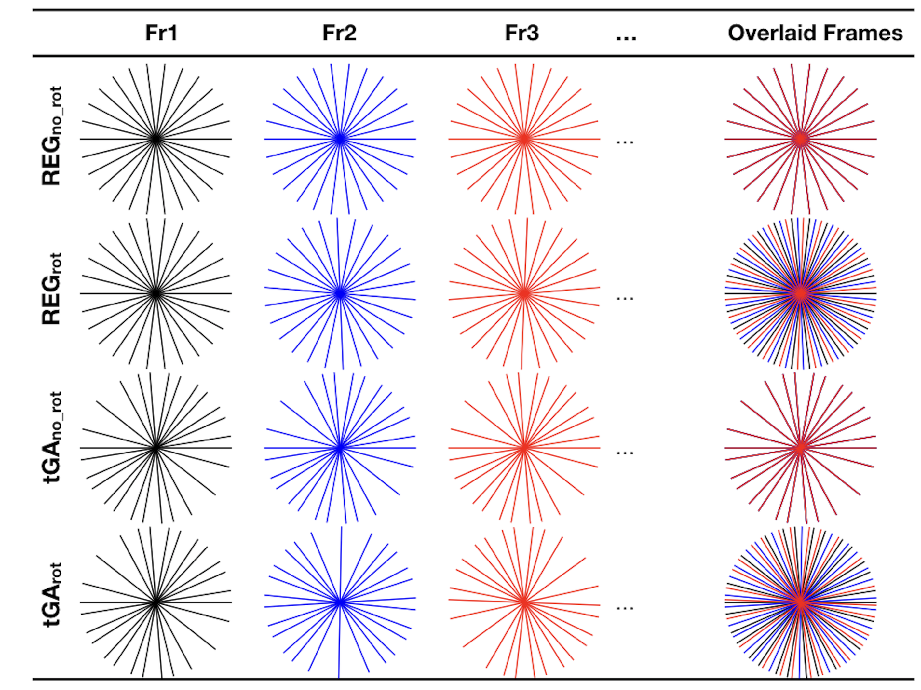
Sampling strategy
Compared radial trajectories;
REGno_rot: regular angle scheme with no rotation between frames
REGrot: regular angle with regular rotation between frames
tGAno_rot: tiny golden angle with no rotation between frames
tGArot: continuously rotating tiny golden angle (~23.63º)
Notes:
There are two main drawbacks of CS, which can limit their clinical uptake: i) they are very computationally intensive and time consuming, and ii) optimisation of reconstruction parameters is challenging, which can lead to unnatural looking images.
A very recently proposed solution is to incorporate machine learning into image reconstruction.
Machine learning networks are becoming a state-of-the-art technique for image de-noising. So the idea is, can we perform a simple reconstruction of under sampled images which produces aliased images, and train a network to remove the aliasing, similarly to a de-noising problem.
The convolutional neural network consists of convolution and pooling layers. The network learn the convolutional filters to map between aliased images and ground truth images, using training data.
To do this we take gold-standard Cartesian BH data, and synthetically under sample them. This paired data fed into the network, for training of the parameters.
The resultant network, can them be presented with a previously unseen aliased data set, and produce an artefact-free image.

Slide 29
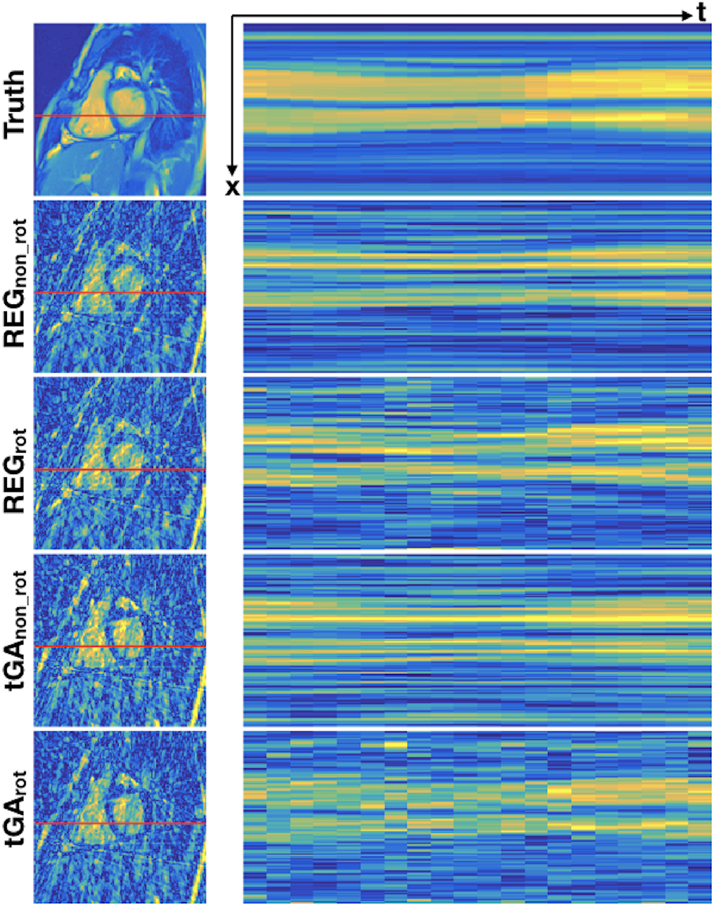
Sampling strategy; artifacts
Notes:
There are two main drawbacks of CS, which can limit their clinical uptake: i) they are very computationally intensive and time consuming, and ii) optimisation of reconstruction parameters is challenging, which can lead to unnatural looking images.
A very recently proposed solution is to incorporate machine learning into image reconstruction.
Machine learning networks are becoming a state-of-the-art technique for image de-noising. So the idea is, can we perform a simple reconstruction of under sampled images which produces aliased images, and train a network to remove the aliasing, similarly to a de-noising problem.
The convolutional neural network consists of convolution and pooling layers. The network learn the convolutional filters to map between aliased images and ground truth images, using training data.
To do this we take gold-standard Cartesian BH data, and synthetically under sample them. This paired data fed into the network, for training of the parameters.
The resultant network, can them be presented with a previously unseen aliased data set, and produce an artefact-free image.

Slide 30
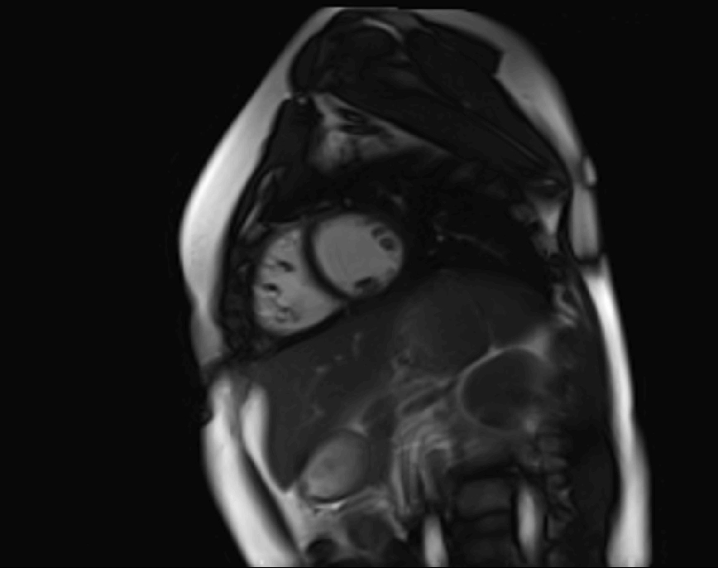
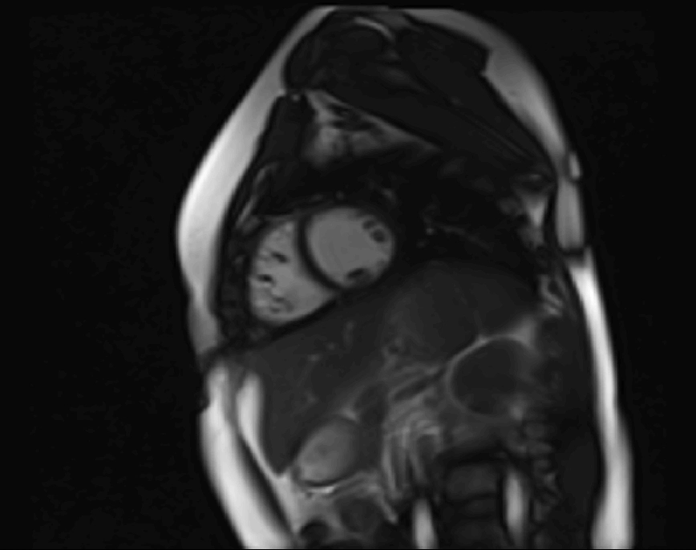
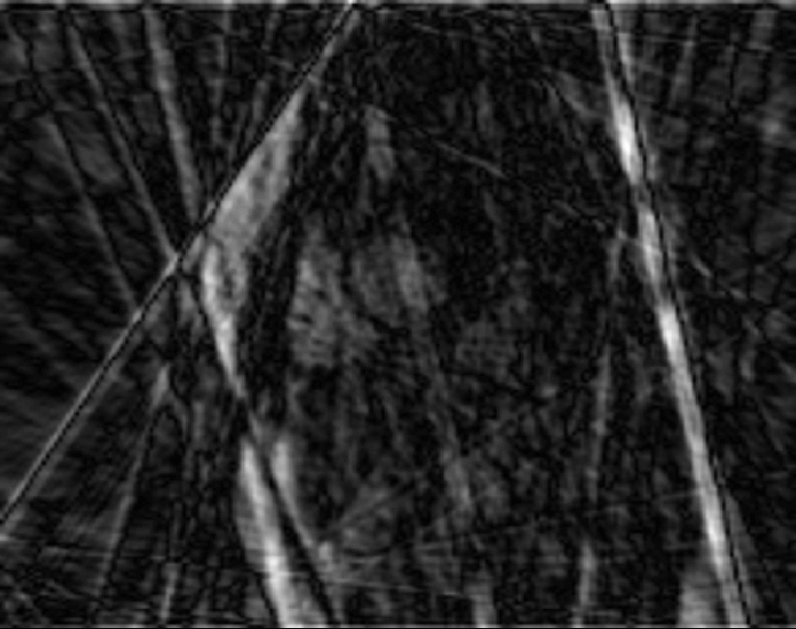
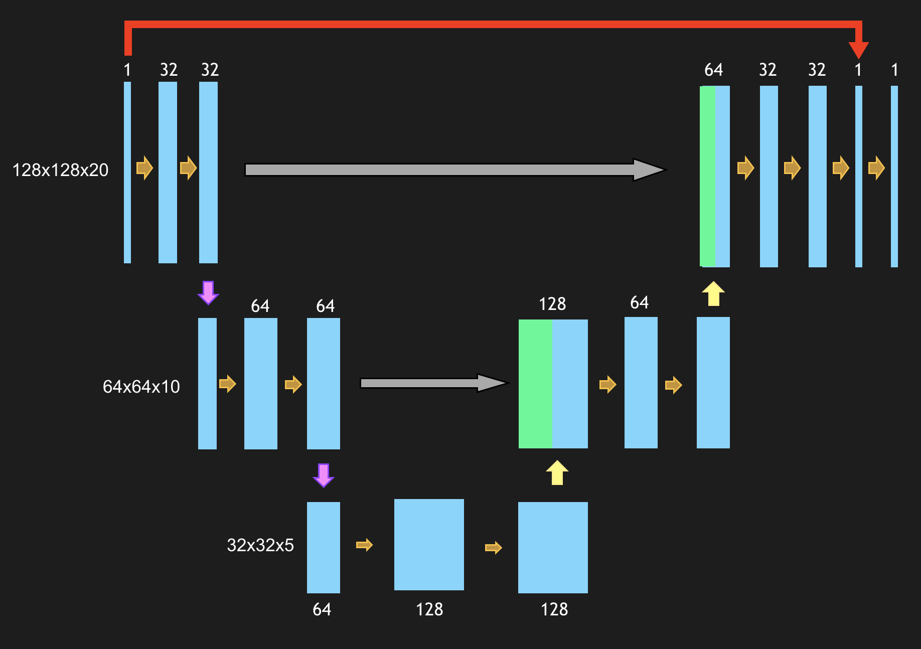
Preparation of training data and training
1.4mm - 40 Frames
1.7mm - 36 ms
Undresampled
DICOM data
Simulated RT
Resampled RT
Output - 2276 cine
Input - 2276 cine
10 CHD patients
Standard BH cine
Real-time tGA Radial
ML reconstruction
Compressed Sensing
Tensorflow

Slide 31
Synthetic data
Training data:
250 patients with CHD (mean age: 22.3±12.6 years, male: 140)
~9 2D slices/each
2276 paired 3D data sets
Test data (previously unseen):
25 patients with CHD (mean age: 24.3±13.3 years, male: 13)
~9 2D slices/each
225 paired 3D data sets
Notes:
There are two main drawbacks of CS, which can limit their clinical uptake: i) they are very computationally intensive and time consuming, and ii) optimisation of reconstruction parameters is challenging, which can lead to unnatural looking images.
A very recently proposed solution is to incorporate machine learning into image reconstruction.
Machine learning networks are becoming a state-of-the-art technique for image de-noising. So the idea is, can we perform a simple reconstruction of under sampled images which produces aliased images, and train a network to remove the aliasing, similarly to a de-noising problem.
The convolutional neural network consists of convolution and pooling layers. The network learn the convolutional filters to map between aliased images and ground truth images, using training data.
To do this we take gold-standard Cartesian BH data, and synthetically under sample them. This paired data fed into the network, for training of the parameters.
The resultant network, can them be presented with a previously unseen aliased data set, and produce an artefact-free image.

Slide 32
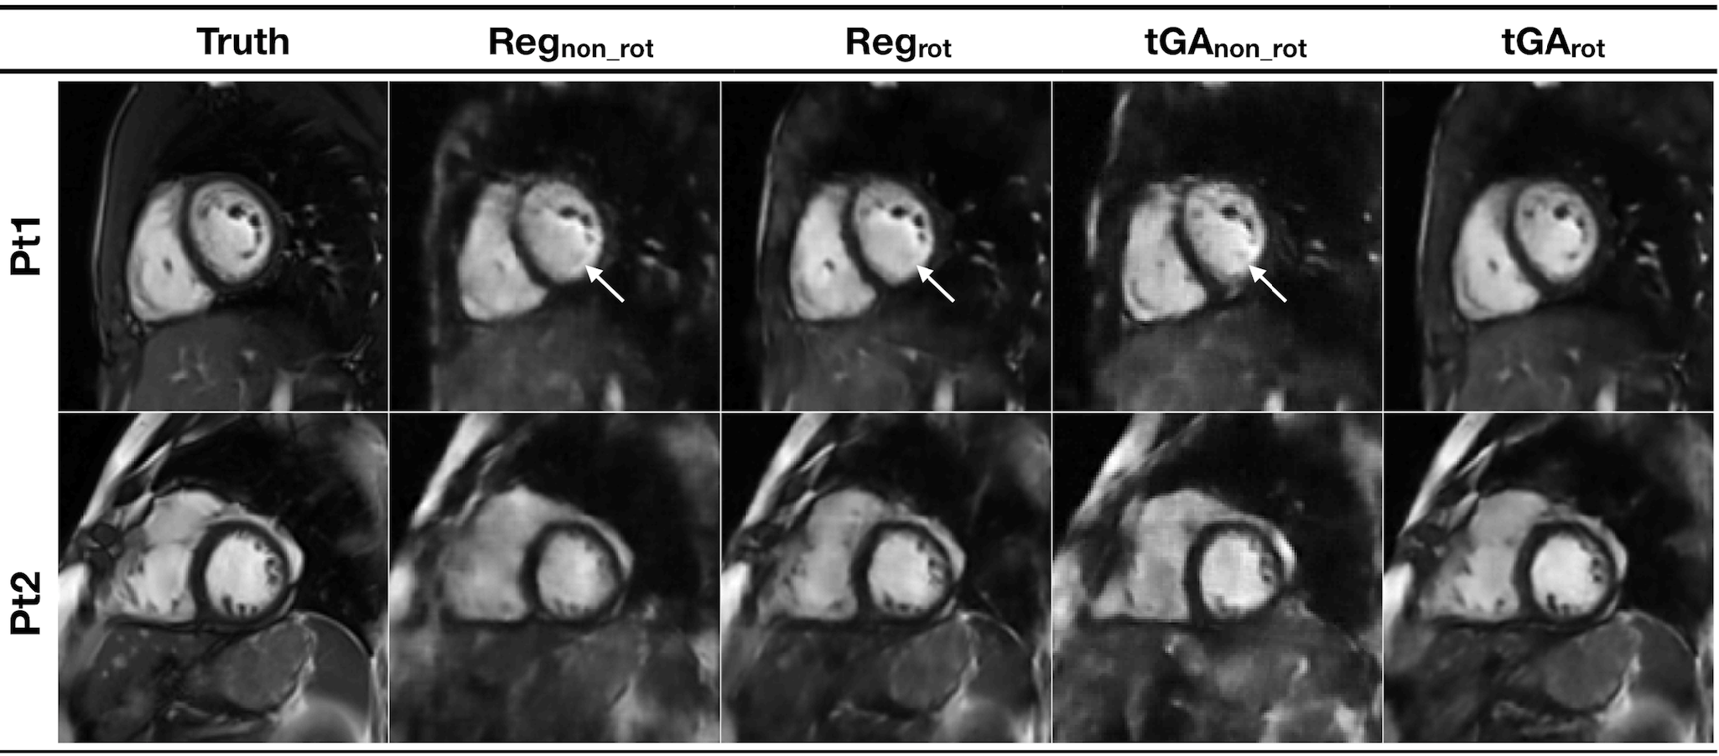
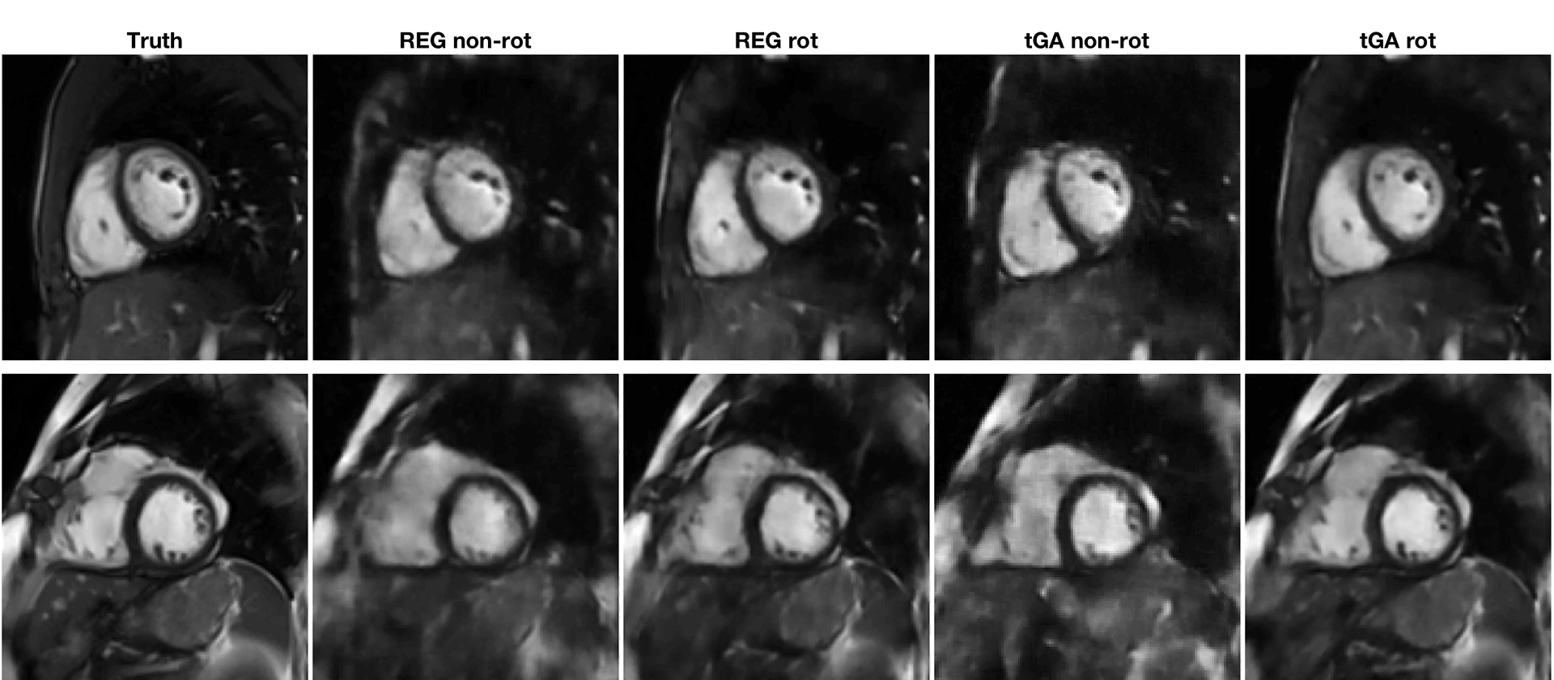
Synthetic test data; Results
Vide S2 in supporting information
 | REGno_rot | REGrot | tGAno_rot | tGArot
RMSE (x10⁻²) | 8.0 ± 1.5 * | 4.9 ± 1.0 * | 8.4 ± 1.6 * | 4.2 ± 1.3
SSIM | 0.64 ± 0.04 * | 0.83 ± 0.03 * | 0.63 ± 0.05 * | 0.87 ± 0.03
Papillary deformation | 92% * | 20% * | 88% * | 0%
Motion artifact | 48% * | 24% * | 48% * | 4%
Blur of endocardialboarder | 100% * | 68% | 100% * | 52%

Slide 33
Prospective data
tGArot bSSFP real-time radial sequence
R=13, 14 radial spokes
Spatial resolution ~1.67x1.67 mm
Temporal resolution ~ 36.4 ms
10 patients with CHD (mean age: 33.6±16.8 years, male: 3)
~12 2D slices/each
122 3D data sets
Notes:
There are two main drawbacks of CS, which can limit their clinical uptake: i) they are very computationally intensive and time consuming, and ii) optimisation of reconstruction parameters is challenging, which can lead to unnatural looking images.
A very recently proposed solution is to incorporate machine learning into image reconstruction.
Machine learning networks are becoming a state-of-the-art technique for image de-noising. So the idea is, can we perform a simple reconstruction of under sampled images which produces aliased images, and train a network to remove the aliasing, similarly to a de-noising problem.
The convolutional neural network consists of convolution and pooling layers. The network learn the convolutional filters to map between aliased images and ground truth images, using training data.
To do this we take gold-standard Cartesian BH data, and synthetically under sample them. This paired data fed into the network, for training of the parameters.
The resultant network, can them be presented with a previously unseen aliased data set, and produce an artefact-free image.

Slide 34
Clinical study
Breath hold
Acquisition time = 279±65 s
CS - 111s recon
Acquisition time = 18±3 s
U-Net - 22s recon
Video S3 supporting information

Slide 35
Prospective data; Results
Acquisition time
Reference standard BH-bSSFP: 279±65 s
Real-time radial bSSFP: 18±3 s
Reconstruction Time: (radial data, all slices)
Deep artifact suppression: ~22.0 s
GRASP : ~111.4 s
Notes:
There are two main drawbacks of CS, which can limit their clinical uptake: i) they are very computationally intensive and time consuming, and ii) optimisation of reconstruction parameters is challenging, which can lead to unnatural looking images.
A very recently proposed solution is to incorporate machine learning into image reconstruction.
Machine learning networks are becoming a state-of-the-art technique for image de-noising. So the idea is, can we perform a simple reconstruction of under sampled images which produces aliased images, and train a network to remove the aliasing, similarly to a de-noising problem.
The convolutional neural network consists of convolution and pooling layers. The network learn the convolutional filters to map between aliased images and ground truth images, using training data.
To do this we take gold-standard Cartesian BH data, and synthetically under sample them. This paired data fed into the network, for training of the parameters.
The resultant network, can them be presented with a previously unseen aliased data set, and produce an artefact-free image.

Slide 36
Prospective data; Results x-t
Notes:
There are two main drawbacks of CS, which can limit their clinical uptake: i) they are very computationally intensive and time consuming, and ii) optimisation of reconstruction parameters is challenging, which can lead to unnatural looking images.
A very recently proposed solution is to incorporate machine learning into image reconstruction.
Machine learning networks are becoming a state-of-the-art technique for image de-noising. So the idea is, can we perform a simple reconstruction of under sampled images which produces aliased images, and train a network to remove the aliasing, similarly to a de-noising problem.
The convolutional neural network consists of convolution and pooling layers. The network learn the convolutional filters to map between aliased images and ground truth images, using training data.
To do this we take gold-standard Cartesian BH data, and synthetically under sample them. This paired data fed into the network, for training of the parameters.
The resultant network, can them be presented with a previously unseen aliased data set, and produce an artefact-free image.

Slide 37
Prospective data; Results
 | BH-bSSFP | RT GRASP | RT U-Net
ES (cm⁻¹) | 0.66 ± 0.15 | 0.38 ± 0.08 *† | 0.55 ± 0.14 *
Endocardial border sharpness | 4.7 ± 0.45 | 3.4 ± 0.49 *† | 4.2 ± 0.75
Wall Motion Blurring | 4.8 ± 0.40 | 3.4 ± 0.49 *† | 4.3 ± 0.46
Residual Artifact | 4.9 ± 0.30 | 3.8 ± 0.40 *† | 4.6 ± 0.49

Slide 38
Prospective data; LV volumes
 | Mean ± Standard deviation |  |  | Bias (Limits of agreement)
 | BH-bSSFP | RT GRASP | RT U-Net | RT GRASP | RT U-Net
LV EDV (mL) | 148 ± 44 | 143 ± 44 | 151 ± 46 | -4.6 (-19.2 to 10.0) | 3.0 (-11.9 to 17.9)
LV ESV (mL) | 56 ± 27 | 60 ± 29* | 58 ± 29 | 4.1 (-8.0 to 16.2) | 1.9 (-7.9 to 11.7)
LV EF (%) | 64 ± 10 | 60 ± 11*† | 63 ± 11 | -4.1 (-9.5 to 1.3) | -0.3 (-4.1 to 3.5)
EDV
ESV
EF

Slide 39
Prospective data; RV volumes
 | Mean ± Standard deviation |  |  | Bias (Limits of agreement)
 | BH-bSSFP | RT GRASP | RT U-Net | RT GRASP | RT U-Net
RV EDV (mL) | 213 ± 97 | 198 ± 89*† | 204 ± 92 | -14.9 (-33.4 to 3.6) | -8.6 (-23.2 to 6.0)
RV ESV (mL) | 92 ± 49 | 89 ± 48 | 91 ± 47* | -3.0 (-16.0 to 10.0) | -1.1 (-22.3 to 20.1)
RV EF (%) | 58 ± 7 | 57 ± 6 | 57 ± 6 | -1.5 (-9.1 to 6.1) | -1.4 (-9.5 to 6.7)
EDV
ESV
EF

Slide 40
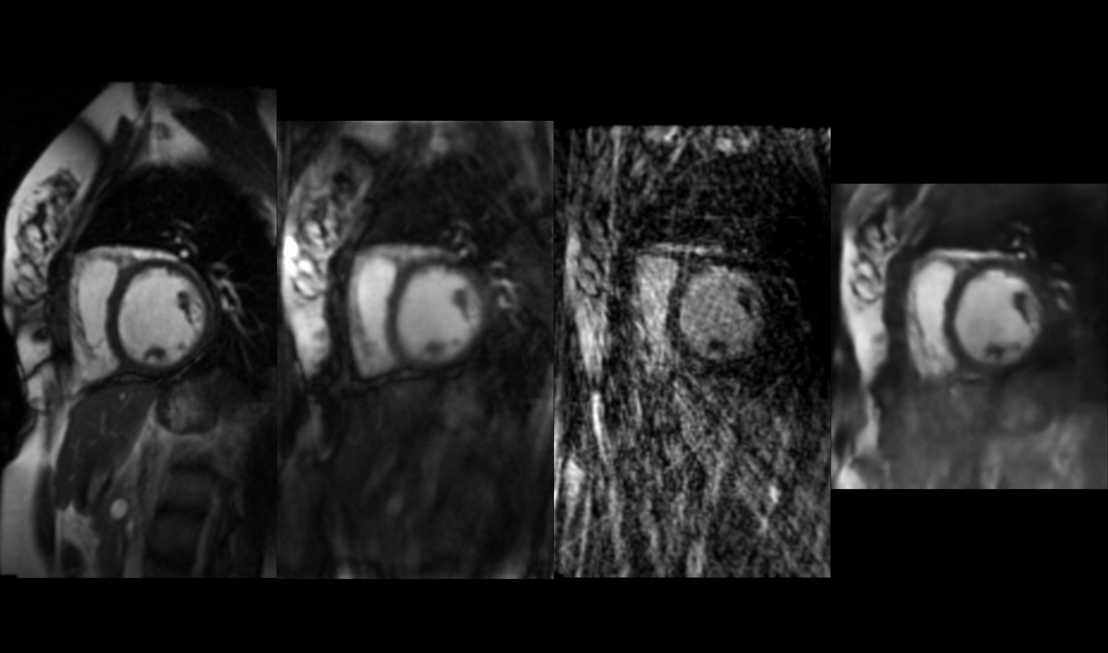
Machine Learning - Ventricular function
3D CNN; 2D + time
222 3D synthetic test data sets
2276 paired 3D Training data sets
RMSE was 4.1±1.1%
90 3D prospective test data sets
CNN 50x faster than CS
BH
CS
Aliased
CNN
Spatial resolution; 1.5 x 1.5 mm
Spatial resolution; 1.7 x 1.7 mm
Temporal resolution; 35 ms
Temporal resolution; 36 ms
Breath-hold time; ~6 s/slice
Free-breathing; 1 RR/slice
Notes:
We treated all data as 3D volumes; 2D + time. 2276 paired 3D data sets from CHD patients were used for training of the network. Synthetic test data was created from standard Cartesian BH data, for 222 volumes. The resultant network successfully reconstructed these image with < 5% error.
In addition, we tested the resultant network on prospectively acquired radial undersampled real-time volumetric data, from 10 patients, each with ~9 slices. This data was also reconstructed using a reference compressed sensing algorithm, Similarly to the previous compressed sensing study, the resolution of the RT data was comparable to the reference standard BH technique, with significantly shorter acquisition times. Image quality was good for both he CS and de-aliasing recosntrctions, however, the CNN was found to be ~ 50x faster than CS algorithm. This may aid clinical uptake of these fast acquisition techniques.

